Slide 1
Chapter 8
CONFIDENCE INTERVALS, EFFECT SIZE, & POWER

Slide 2

Step 6: Make a Decision
H₀ : μ₁ = μ₂
H₁ : μ₁ ≠ μ₂
Blueberry supplement had an effect on cognitive functioning.
Blueberry supplement resulted in a statistically significant improvement in performance, z = 3.29, p < .05

Slide 3
“Statistically Significant”
Indicates that data differ from what we would expect if H₀ were true
Does not necessarily mean important or meaningful difference
Small differences in means can produce statistically significant results

Slide 4
Additional Calculations
Confidence intervals
Effect size
Statistical power

Slide 5
Confidence Intervals
Point estimate
  Statistic as an estimate of a parameter
Interval estimate
  Use a statistic to build a range of plausible values for a parameter
  Confidence interval includes μ a certain percentage of the time
    Typically set at 95%

Slide 6
Example
M_{lower} = - z(σ_{M}) + M_{sample} M_{upper} = z(σ_{M}) + M_{sample}
= - 1.96(3.65) + 92 = 1.96(3.65) + 92
= 84.85 = 99.15

Slide 7
Example
95% confidence interval is [84.85, 99.15]
If we were to sample from the population of older adults who take blueberry supplements, this interval would contain the population mean 95% of the time
Gives more information than z test alone

Slide 8
Effect Size
Increasing sample size strongly influences NHST
M – μ_{M}
σ
z =
σ_{M}=
σ_{M}
√ N

Slide 9
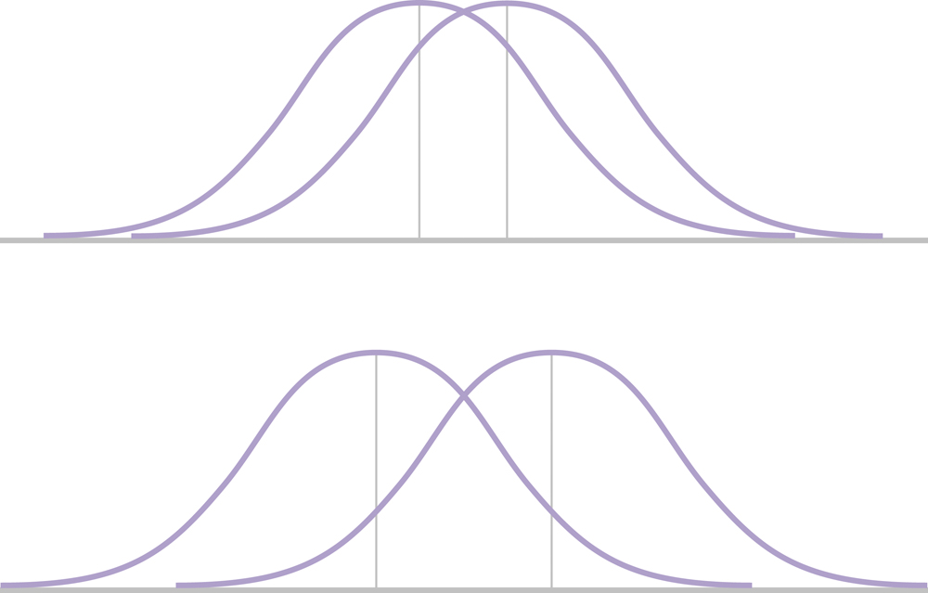
Effect Size
Indicates the size of a difference
Unaffected by sample size
Imagine both represent
statistically significant effects.
Which effect is bigger?

Slide 10
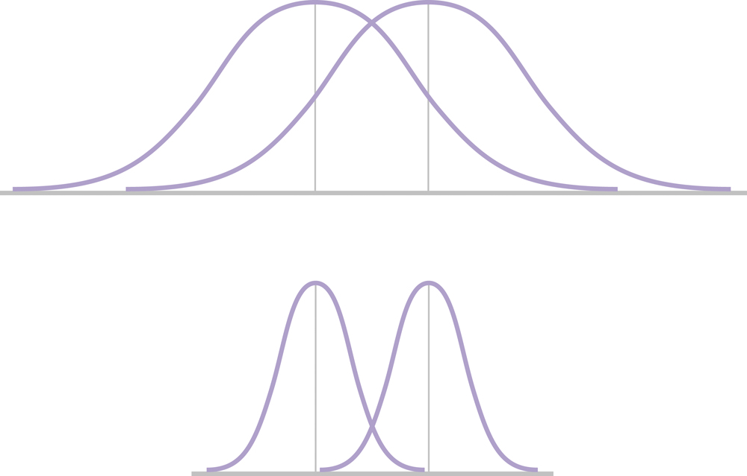
Effect Size
Indicates the size of a difference
Unaffected by sample size
Note the variability in the
distributions.
Which effect is bigger?

Slide 11
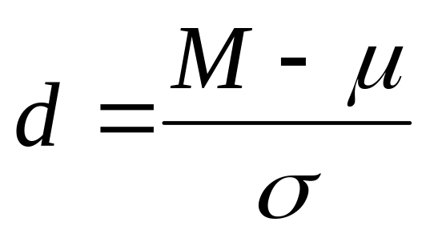
Effect Size
Cohen’s d

Slide 12
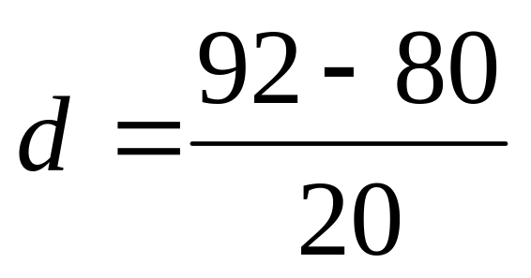
Example
d= 0.6

Slide 13
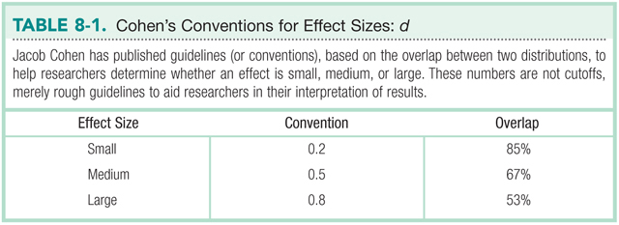
Effect Size

Slide 14
Statistical Power
Ability to reject H₀ when H₀ is false
Probability that we will not make a Type II Error
1-β

Slide 15
Statistical Power
 | Null Hypothesis is True | Null Hypothesis is False
Reject Null Hypothesis | TYPE I ERROR α | CORRECT!
Fail to reject Null Hypothesis | CORRECT! | TYPE II ERROR β

Slide 16
3 ways to increase Power
Increase α
Use a one-tailed test instead of a two-tailed test
Increase N

Slide 17
A word of warning…
Too much power and you run the risk of finding trivially small differences
Too little power and you risk not finding real differences that could be important
Typically looking for power = .80

